Slide 1

Kitty Buddy Go!
UPDATE ONE
Single Player 2D Mobile Casual Game
Side Scrolling Platformer
Build in Unity
For mobile players
2017-2019

Slide 2
Target Players(Redefined)
Kids/teens friendly
Girls or ones who like casual game (ex. Tetris, minesweeper)
Not intense
Opposite of Brain burning game
A certain level of achievement

Slide 3
Go-getter
Brave
Ambitious
Impulsive
Character

Slide 4
Game Play Design Modification
Everytime player is blowing, starts scroling(not sure).
Used to be scroling blowing or not. (ex. Mario)
For recude the intensity of game for kids.
Pause function
Abstraction of Obstacles
Obstacles being replaced by blocks with different height and width.
Blocks turn into -> roof top of houses Montreal
Focusing on let player enjoy the voice control challenge
the real charm of this game/core game play design
Remove score , one time life/Live or die situation
Duration of game 2 mins for each level.
Adding sencitivity bar.
Device compatibility

Slide 5
Prototype one
Get mobile develpment process work
Get voice input work
control kitty jumping over block for prototype 1
Scrolling background 65 second for prototype 1
touching ground&Game over

Slide 6
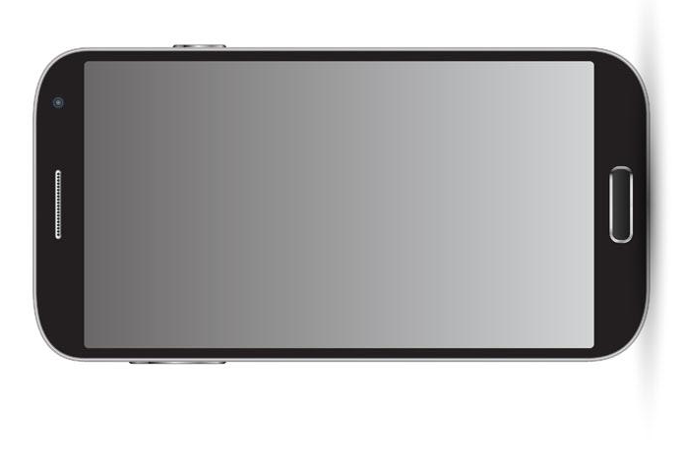
3 Levels
Current level shows on dots
main task is jumping over houses
Generate "houses" with distance and
height and speed
Get used to control kitty by voice input
Adjust sensitivity
Unity 2018 3.3.1f
Android 7.0
Android Studio 3.5.7

Slide 7
To do list
UI
Kid friendly, stylized caroon city view background
Little animtion : tail shaking when he jumps
Map and story telling/level instruction
Montreal typical building roof top
Adding sencitivity bar
Device compatibility
sound effect
Recording Kitty Buddy's voice for real
Level of Dificulity generator
Play with distance and height and speed

Slide 8

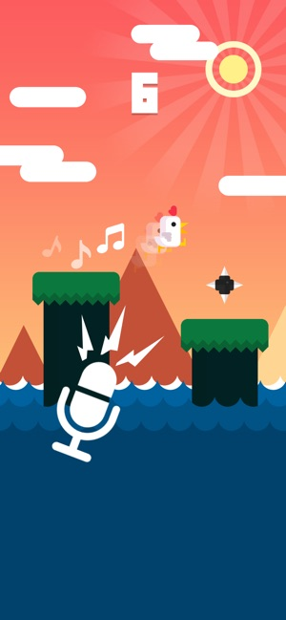
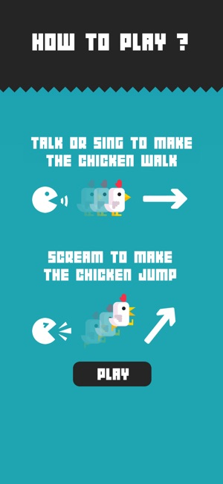
Chicken Scream 2017

Slide 9

Flappy Bird 2013

